Slide 1






PURE: Positive-Unlabeled Recommendation with Generative Adversarial Network
Yao Zhou†, Jianpeng Xu§, Jun Wu†, Zeinab Taghavi§, Evren Korpeoglu§
Kannan Achan§, Jingrui He†
†University of Illinois at Urbana Champaign
§Walmart Labs

Slide 2

Roadmap
Problem Definition
Proposed Model
Preliminary
PU learning based Rec Sys with GAN
Background
Why Rec Sys is important?
Analysis and Results
Theoretical analysis
What are the key component of Rec Sys?
Effectiveness, efficiency, parameter study
What problem we are solving?
What are pros & cons of the existing work?
Conclusion

Slide 3


Ubiquitous Recommendation
Information overload
500 millions tweets posted per day on Twitter
720k hours video uploaded per day on YouTube
1.8 million scientific articles published per year online
Recommendation becomes necessary in every way
E-commerce, e.g., Walmart, Amazon, etc.
Walmart
Amazon

Slide 4


Ubiquitous Recommendation
Information overload
500 millions tweets posted per day on Twitter
720k hours video uploaded per day on YouTube
1.8 million scientific articles published per year online
Recommendation becomes necessary in every way
E-commerce, e.g., Walmart, Amazon, etc.
Content streaming, e.g., YouTube, TikTok, etc.
YouTube
TikTok

Slide 5


Ubiquitous Recommendation
Information overload
500 millions tweets posted per day on Twitter
720k hours video uploaded per day on YouTube
1.8 million scientific articles published per year online
Recommendation becomes necessary in every way
E-commerce, e.g., Walmart, Amazon, etc.
Content streaming, e.g., YouTube, TikTok, etc.
Social networking, e.g., Facebook, LinkedIn, etc.
Facebook
LinkedIn

Slide 6


Ubiquitous Recommendation
Information overload
500 millions tweets posted per day on Twitter
720k hours video uploaded per day on YouTube
1.8 million scientific articles published per year online
Recommendation becomes necessary in every way
E-commerce, e.g., Walmart, Amazon, etc.
Content streaming, e.g., YouTube, TikTok, etc.
Social networking, e.g., Facebook, LinkedIn, etc.
Entertainment, IMDB, AllTrails, etc.
…
IMDB
AllTrails

Slide 7





Components of Recommender Systems
Workflows
Data collection: user behaviors (clicks, impressions, etc.) and interactions (ratings, purchases, etc.) are recorded.
Model training: recommendation models are trained and updated on user’s interaction data.
Model serving: recommendation models infers the preference rankings of each user over the unseen items.
Data
click
train
User
Model
serve

Slide 8
Roadmap
Problem Definition
Proposed Model
Preliminary
PU learning based Rec Sys with GAN
Background
Why Rec Sys is important?
Analysis and Results
Theoretical analysis
What are the key component of Rec Sys?
Effectiveness, efficiency, parameter study
What problem we are solving?
What are pros & cons of the existing work?
Conclusion

Slide 9







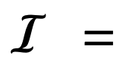
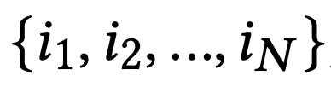
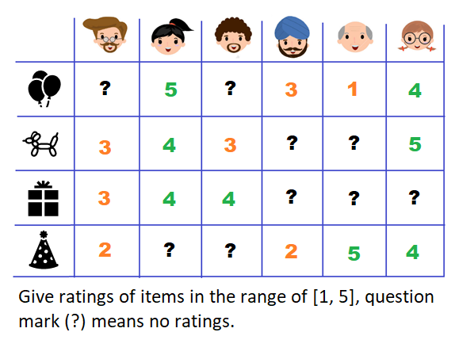


Problem Definition
The collaborative filtering problem in recommendation
Given:
a set of users
a set of items
the observed user-item interaction matrix
Output:
The estimated interaction scores of the
unobserved items for each user in
Illustration of truth inference

Slide 10







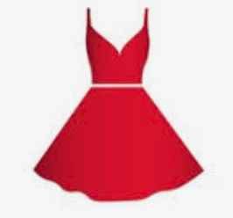



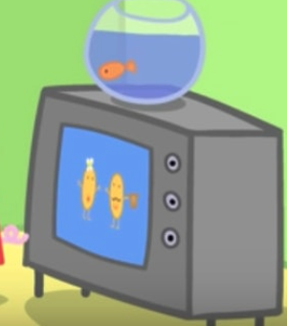
Existing Work
Common pitfalls in existing work
The unobserved/unlabeled interactions between users & items have negative labels
The observed user & items as well as their interactions represent the true relevance distribution.
A few examples
Item ranking
 |  |  |  |  | …
 | ✅ | ? | ? | ? | …
 | ? | ✅ | ? | ? | …
 | ? | ? | ? | ✅ | …
 | ? | ? | ✅ | ? | …
… | … | … | … | … | …
George only buys a toy dinosaur doesn’t mean he doesn’t like chocolate cake
User
Using only the sparse user-item interactions can not learn the underlying distribution well.
1
likes
doesn’t like
2
likes
3
Illustration of truth inference

Slide 11
Existing Work
Common pitfalls in existing work
The unobserved/unlabeled interactions between users & items have negative labels
The observed user & items as well as their interactions represent the true relevance distribution.
Two novel designs in our proposed approach
Users observe only the positive items and the corresponding remaining items are unlabeled.
Generator generates fake users/items (embeddings) to increase the expressiveness of the ranking model.
Illustration of truth inference

Slide 12
Roadmap
Problem Definition
Proposed Model
Preliminary
PU learning based Rec Sys with GAN
Background
Why Rec Sys is important?
Analysis and Results
Theoretical analysis
What are the key component of Rec Sys?
Effectiveness, efficiency, parameter study
What problem we are solving?
What are pros & cons of the existing work?
Conclusion

Slide 13
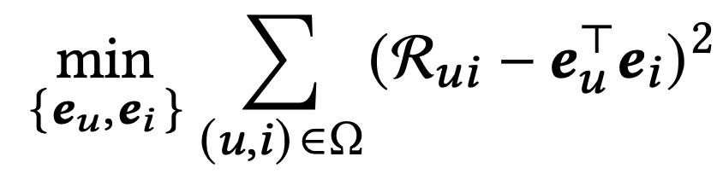
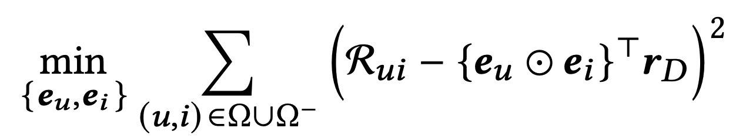
Preliminary
Matrix factorization (MF)
MF maps both users and items into a joint latent factor space.
MF assumes all latent feature are equally important.
Generalized matrix factorization (GMF)
GMF assume each latent feature has relation mapping.
Xiangnan He, et al. Neural Collaborative Filtering. WWW 2017.
Illustration of truth inference

Slide 14
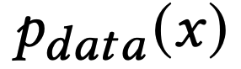
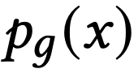
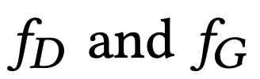
Preliminary
Generative adversarial network (GAN)
Minimax game between the generator G and the discriminator D
G generates fake data to confuse D
D distinguishes the real-world data and the fake data from G
Objectives of GAN with defined loss functions
Note: and are the distributions of real-world data and fake data.
are the loss functions of D and G respectively.
Ian Goodfellow, et al. Generative Adversarial Networks. NeurIPS 2014.
Illustration of truth inference

Slide 15
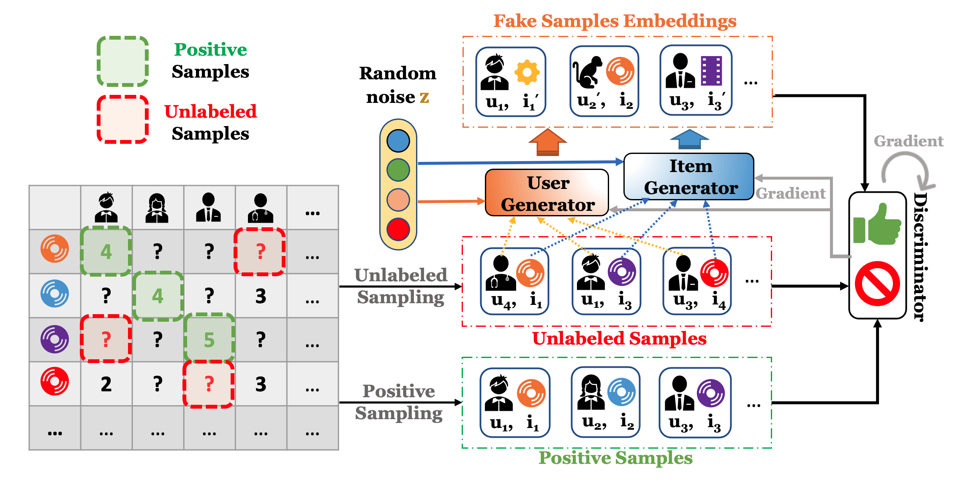
Proposed Approach – PURE
The model architecture with GAN

Slide 16
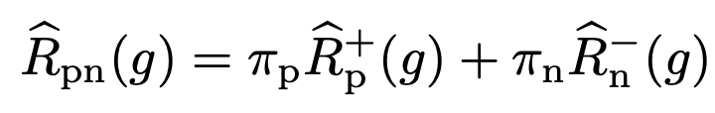
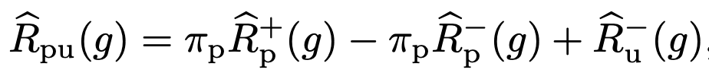
Proposed Approach – PURE
Recommendation with unlabeled sampling
Traditional positive-negative (PN) sampling assumes unobserved entries are all negatives.
Positive-unlabeled (PU) sampling explicitly model the unlabeled samples and treat the unobserved entries as a mixture of positive & negative examples.
Class-prior probabilities
Ryuichi Kiryo, et al., Positive-Unlabeled Learning with Non-Negative Risk Estimator. NeurIPS 17

Slide 17








Proposed Approach – PURE
Recommendation with unlabeled sampling
Positive-unlabeled (PU) sampling explicitly model the unlabeled samples and treat the unobserved entries as a mixture of positive & negative examples.
 |  |  |  |  | …
 | 1 | ? | ? | ? | …
 | ? | 1 | ? | ? | …
 | ? | ? | ? | 1 | …
 | ? | ? | 1 | 1 | …
… | … | … | … | … | …
Sampled positive examples
Sampled unlabeled examples

Slide 18
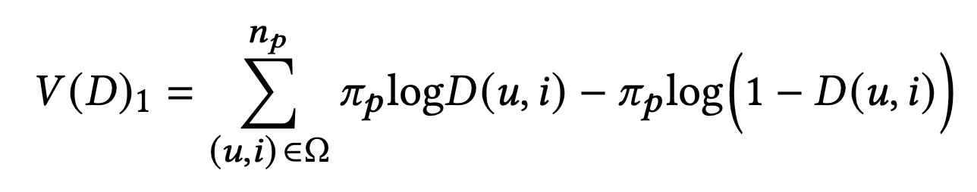
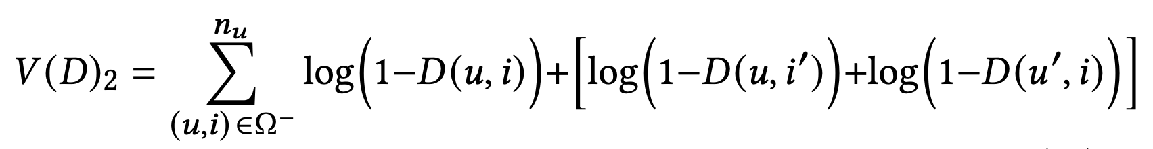
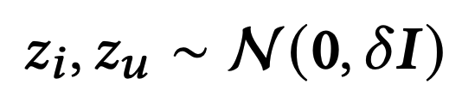
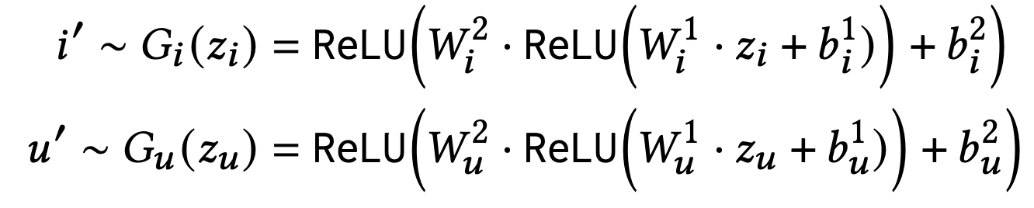
Proposed Approach – PURE
PURE formulation
Discriminator – PU learning based pointwise ranking model
Positive samples from the given observations:
Unlabeled samples from both the unobserved interactions and the generator:
Generator – multi-layer perceptron, where
# of (u, i) interactions
Two loss terms to comply with PU learning
# unlabeled interactions
Two-layer MLP with ReLU activations

Slide 19
Roadmap
Problem Definition
Proposed Model
Preliminary
PU learning based Rec Sys with GAN
Background
Why Rec Sys is important?
Analysis and Results
Theoretical analysis
What are the key component of Rec Sys?
Effectiveness, efficiency, parameter study
What problem we are solving?
What are pros & cons of the existing work?
Conclusion

Slide 20
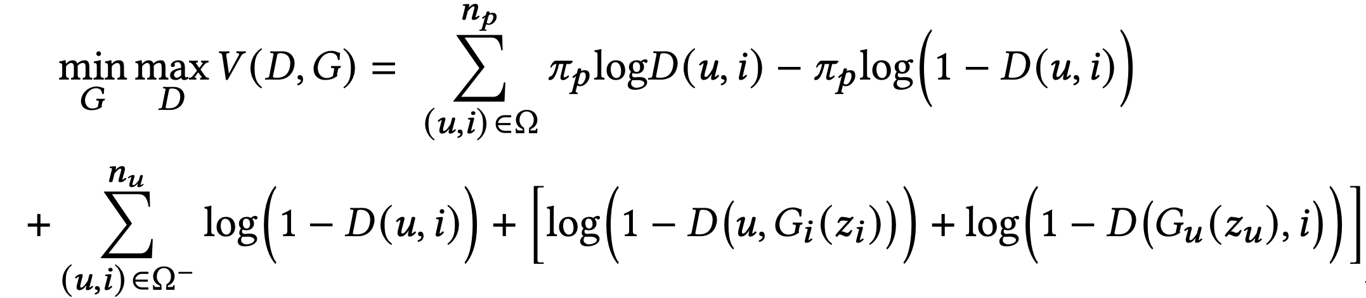
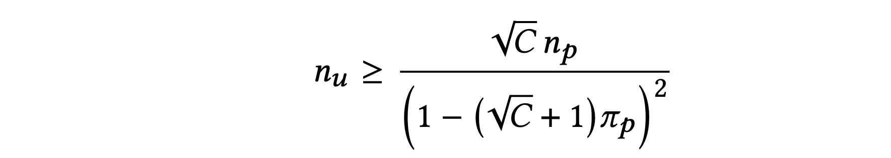
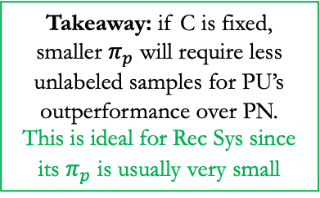
Theoretical Analysis
PURE formulation
Overall objective
Theorem 1. [Unlabeled Sampling] The estimation error bound of PU learning is tighter than that of PN learning if and only if:
Corresponding negative sampling ratio of PN learning
Takeaway: if C is fixed, smaller $π_{p}$ will require less unlabeled samples for PU’s outperformance over PN.
This is ideal for Rec Sys since its $π_{p}$ is usually very small

Slide 21
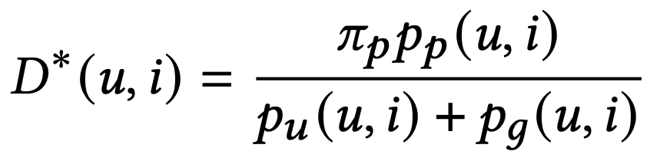
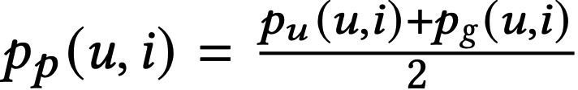
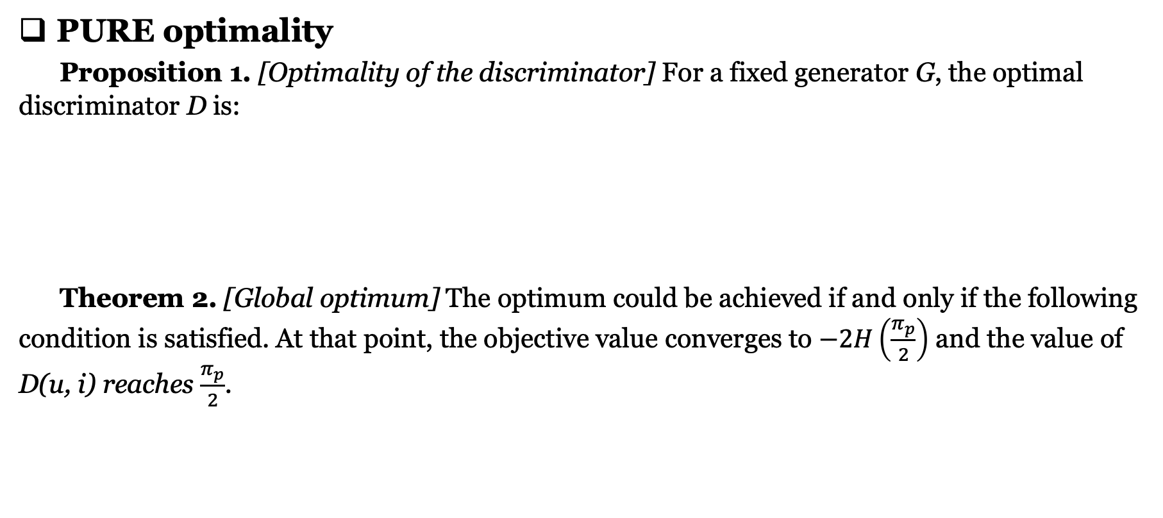
Theoretical Analysis
PURE optimality
Proposition 1. [Optimality of the discriminator] For a fixed generator G, the optimal discriminator D is:
Theorem 2. [Global optimum] The optimum could be achieved if and only if the following condition is satisfied. At that point, the objective value converges to $−2H\left(\frac{π_{p}}{2}\right)$ and the value of D(u, i) reaches $\frac{π_{p}}{2}$.
A balance between positive distribution, unlabeled distribution, and generated distribution.
Generator will produce highly relevant embeddings that are similar to the true user-item relevance distribution.

Slide 22
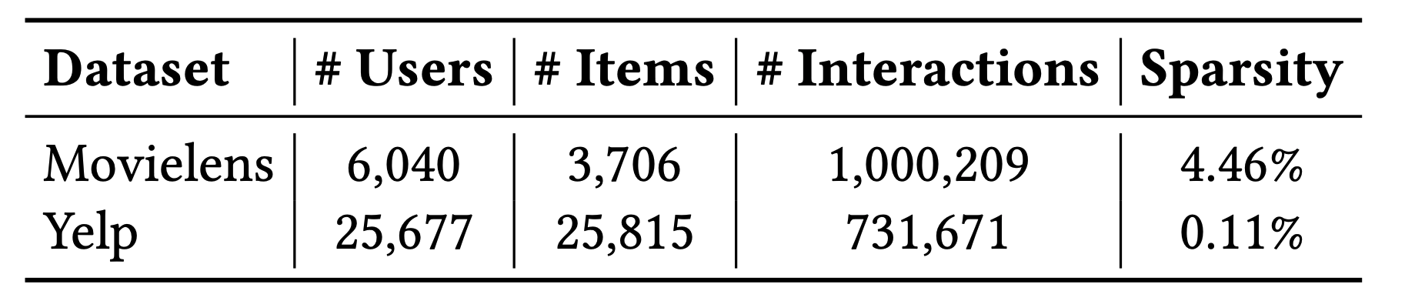
Experiments
Experimental settings
Data sets:
Movielens
Yelp
Evaluation protocol*:
80%|20% random split with leave-10-out (Movielens) or leave-5-out (Yelp) in testing.
Sampled evaluation with 500 candidate items
Five categories of baselines:
Traditional collaborative filtering
Traditional matrix factorization
Neural collaborative filtering
GAN-based recommenders
PU-learning based recommenders
Metrics
P@k, k = 3, 5, 10
NDCG@k, k = 3, 5, 10
MAP
MRR
* This sample evaluation protocol is applied on all baselines and comparable between them only. It is distinctively different from the leave-one-out evaluations.

Slide 23
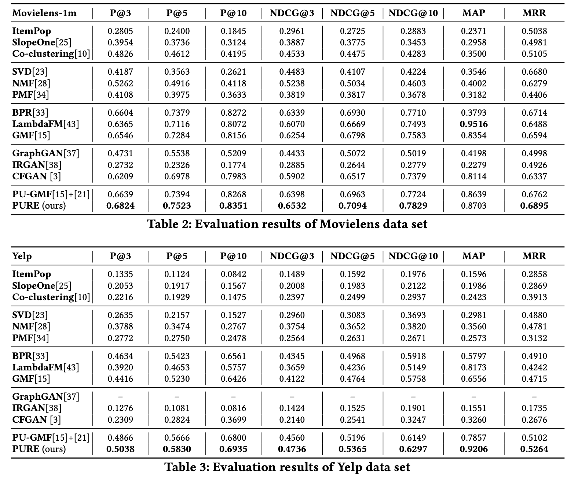
Experiments
Experimental results
Traditional CF
MF based
Neural MF
GAN based
PU based
Traditional CF
MF based
Neural MF
GAN based
PU based

Slide 24
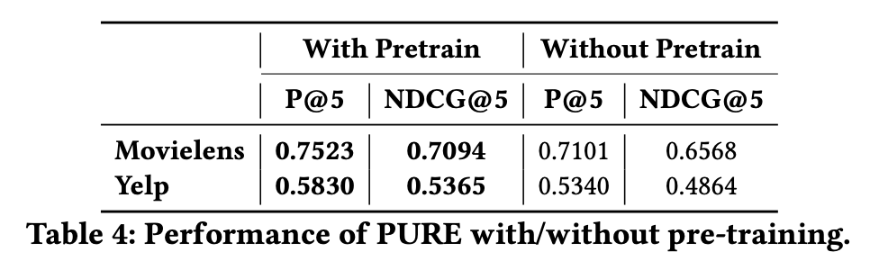
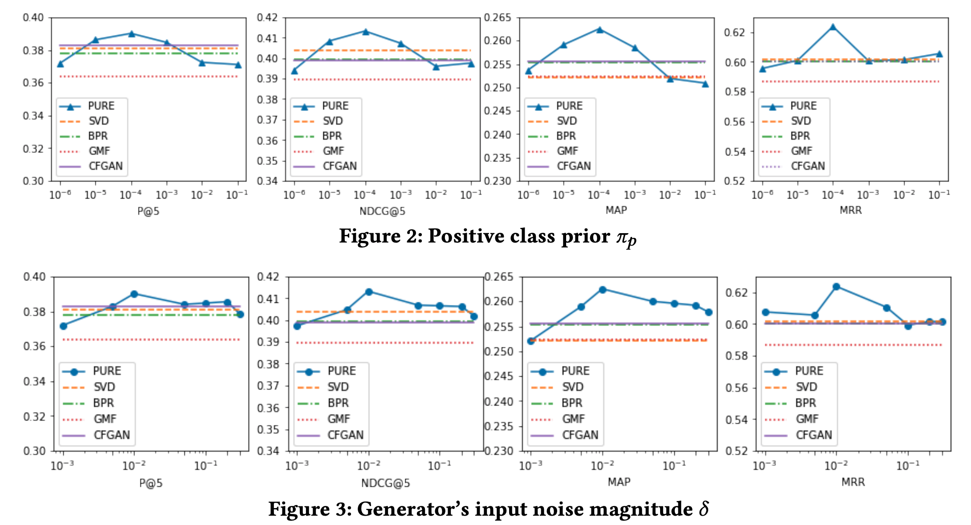
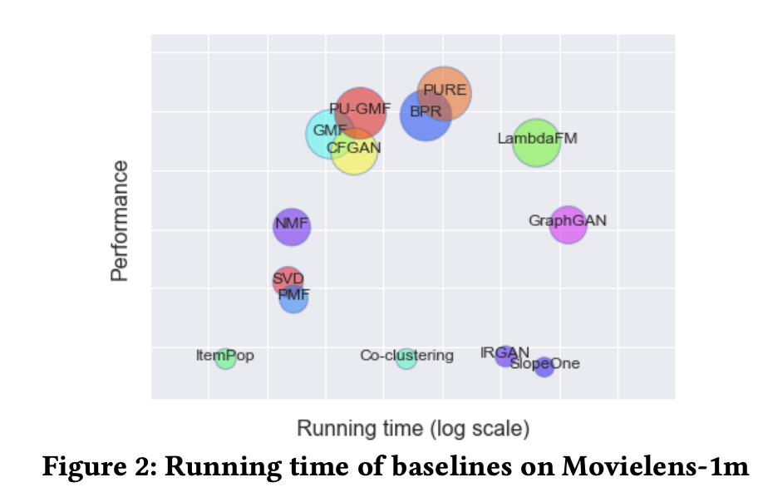
Experiments
Pretrain, scalability, and ablation study

Slide 25
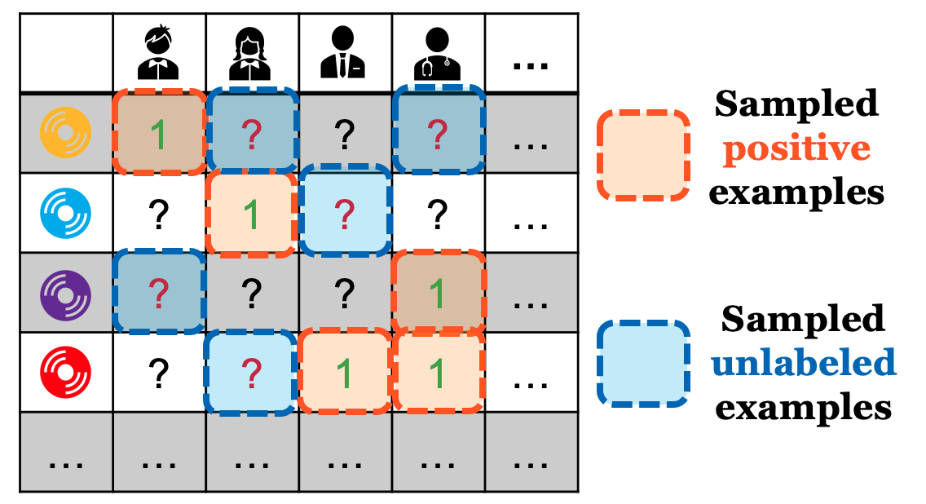
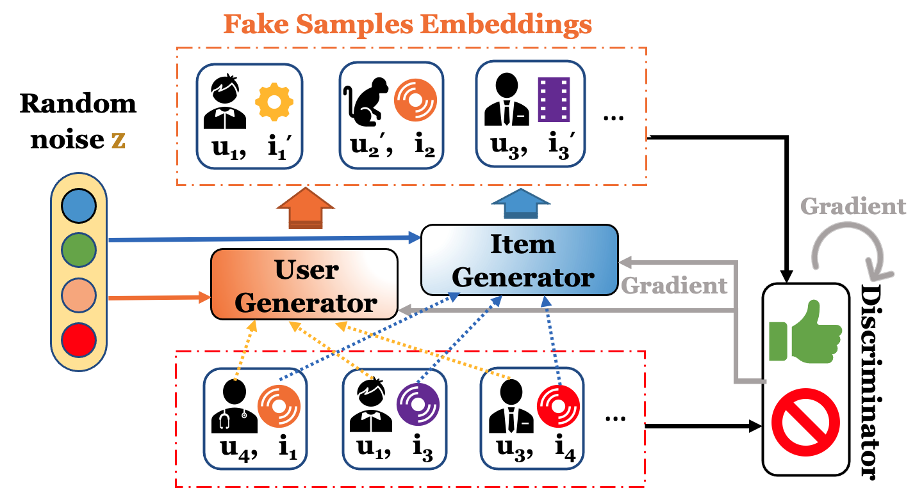
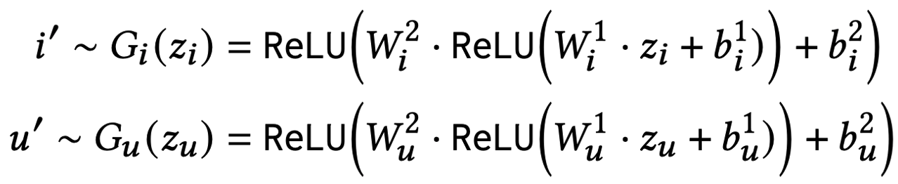
Conclusion
Positive-unlabeled learning fits well with recommender systems.
Augment data set with fake embeddings can further improve the expressiveness of the ranking model.
Generators that generate fake embeddings don’t have to be too complex.
Pretrain is effective and efficient.
Evaluation for recommender systems is time-consuming and need more effort to explore.

Slide 26
THANK YOU!
&
Questions?
Contact: Yao Zhou (Email: yaozhou3@Illinois.edu)
Code: https://drive.google.com/file/d/1f82giul6W1nAtposWdVy9z1G6lXwkHxT/view

